Slide 1
Competency Skill Matrix

Slide 2
Agenda
1
Problem statement
2
Architecture diagram of the application
3
Technology stacks
4
Requirements & Approaches
5
Screenshot

Slide 3
Develop a Tracker for Competency Skill Matrix for the organization.
Competency Skill Matrix
Problem Statement
Outcomes
Create a Tracker to store the Employee details with their Skills. Allow users to add their skills
The problem statement is to create a tracker for storing Employee details along with their associated skills. Users should be able to add skills to an employee's profile within this tracker.
One approach would involve developing a user-friendly web-based for inputting and managing employee details, while also integrating a database system to store employee profiles along with their associated skills.
Additionally, the system should incorporate a feature allowing users to easily add skills from an employee's record as needed.
Outputs
SSL
BLADE TEMPLATE VIEWS
HTTPS
211618_001

Slide 4

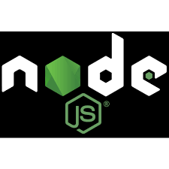


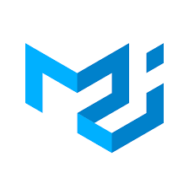
Architecture diagram of the application
Competency Skill Matrix
Technical Architecture
Authentication
Routes
Controllers
React JS
User
Business Logic
PostgreSQL
Material UI
Frontend
Configs
Packages
Backend

Slide 5
Technology stacks
Competency Skill Matrix
Technology stacks | Technology | Features
Frontend | React JS, HTML, CSS, Material UI | React.js facilitates the creation of interactive web applications through efficient, component-based UI development. HTML, CSS, and MUI serve as the groundwork for designing web interfaces that are both visually pleasing and responsive, adhering to standardized structure and styling principles.
Backend | Node JS | Node.js provides the capability to develop rapid server-side JavaScript applications and benefits from an extensive collection of modules and packages accessible via npm, streamlining the development process.
Database | MySQL | It offers a visual design interface for the creation and maintenance of database schemas, simplifying the process of designing and managing databases.
Version Control | GitHub | The purpose of GitHub, a version control platform, is to enable collaborative software development by tracking and managing changes to code repositories. It allows developers to work together on projects, track revisions, resolve conflicts, and maintain a history of changes, ensuring code integrity and facilitating efficient collaboration.

Slide 6
Requirements & Approaches
Competency Skill Matrix
Client Requirements
Approach
Create a Tracker to store the Employee details with their Skills. Allow users to add their skills
One method could involve creating a user-friendly web application for entering and overseeing employee information, while also incorporating a database system to store employee profiles along with their respective skills.
Furthermore, the system should include a functionality that permits users to effortlessly append skills to an employee's record as required.

